Slide 1


Webscraping Nasdaq.com
With Scrapy
Cameron Wisdom
+

Slide 2
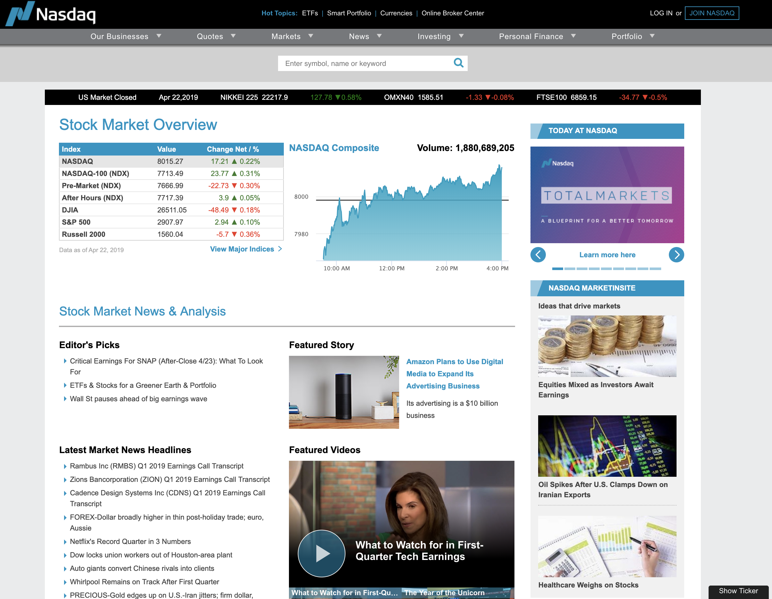
Background
2nd largest stock exchange in the world by Market Cap
World’s first electronic Stock Market
Notable listings include: Microsoft, Oracle, Apple, Cisco, and Dell
Helped modernize the IPO

Slide 3
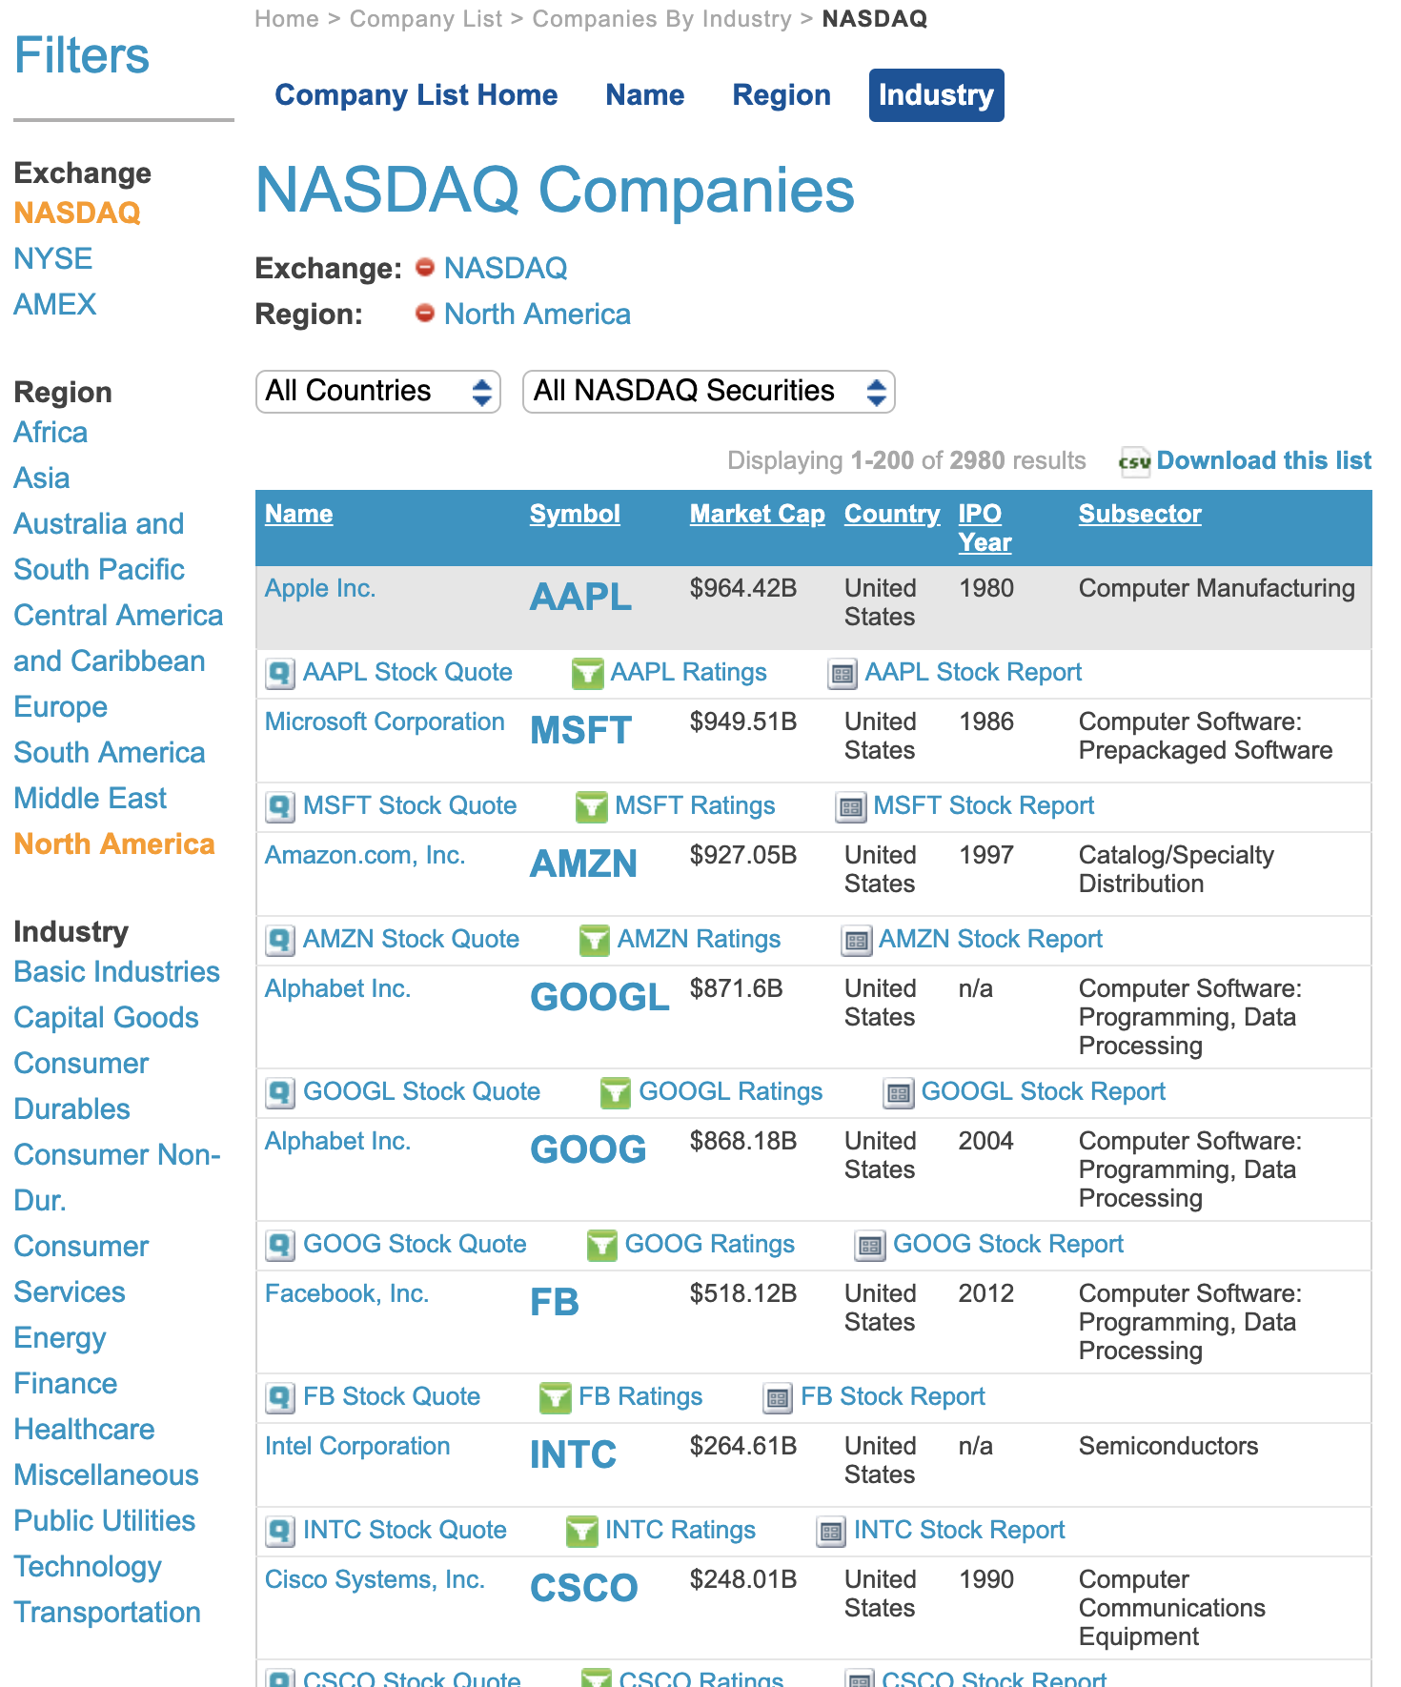
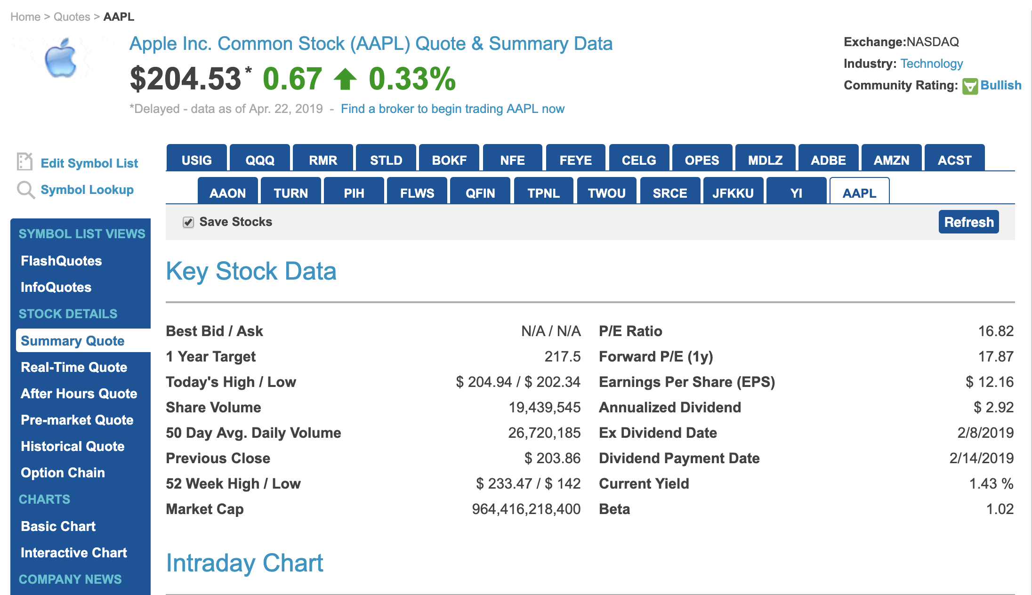
This lovely table is dynamic and changes throughout each day during trading hours.
Interestingly enough, it also omits cells if the information is not available. yay!
Index Page
1 of 15
summary page

Slide 4





The right tools for the job
Scrapy
Pycharm
Github Desktop
ROBOTSTXT_OBEY = False
NordVPN
Caffeine
Selector Gadget
Jupyter notebook
“Hey Siri, how do I export graphs from jupyter notebook? Asking for a friend”

Slide 5
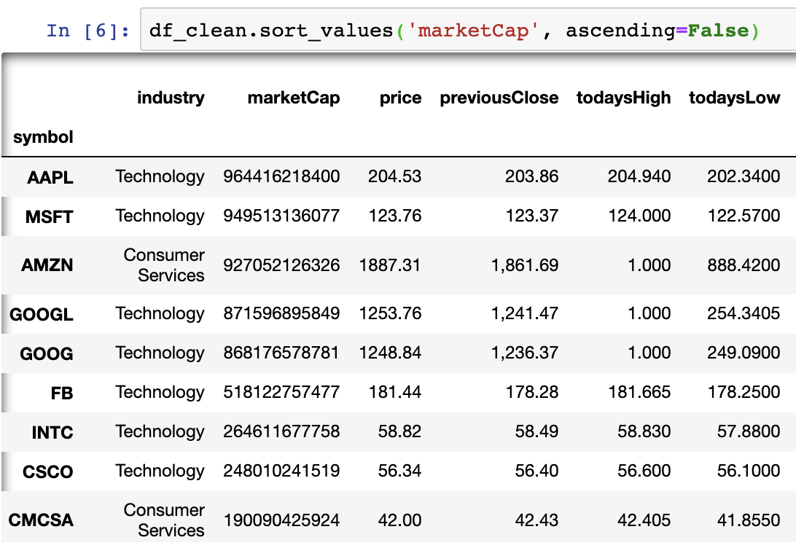


Slide 6

That’s… Interesting
Does your scraped data make sense?

Slide 7
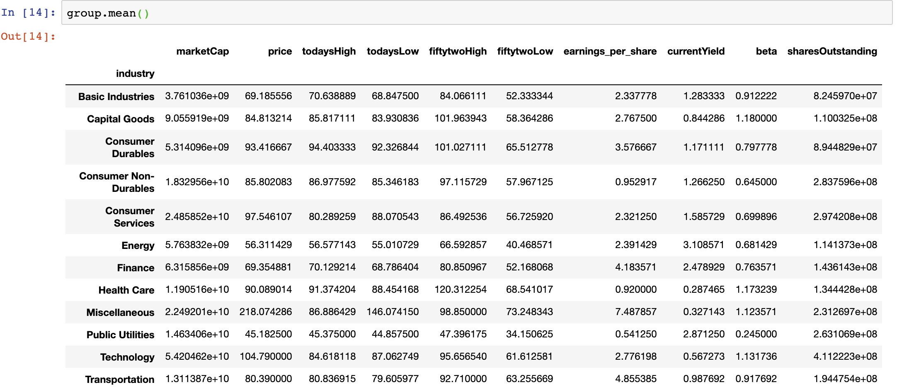

Slide 8
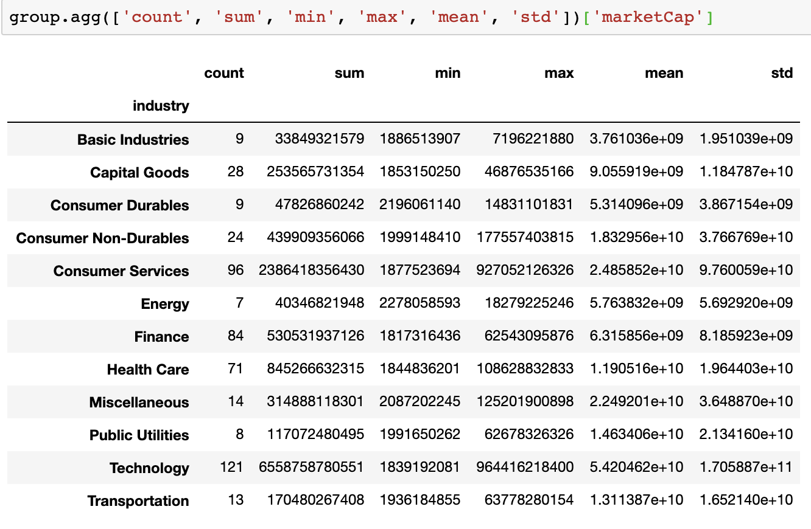

Slide 9
$24.1 billion
Mean Market Capitalization value of the top 500 listings on Nasdaq

Slide 10
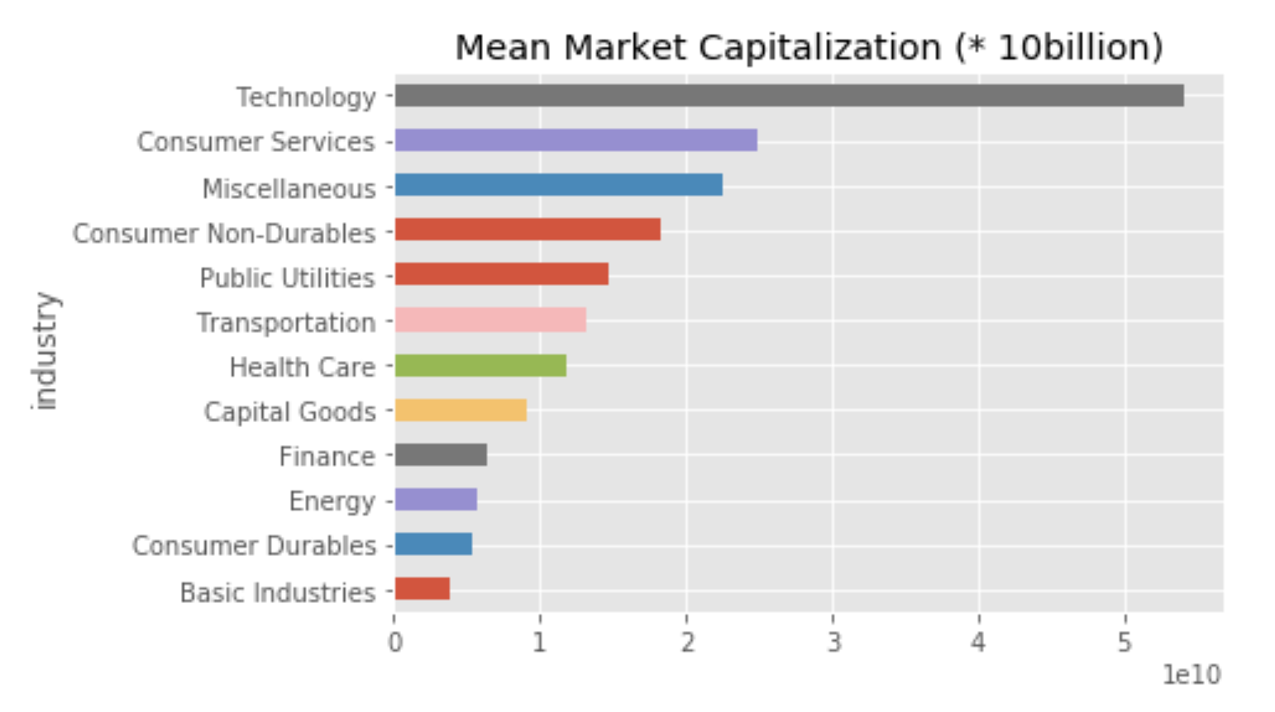

Slide 11
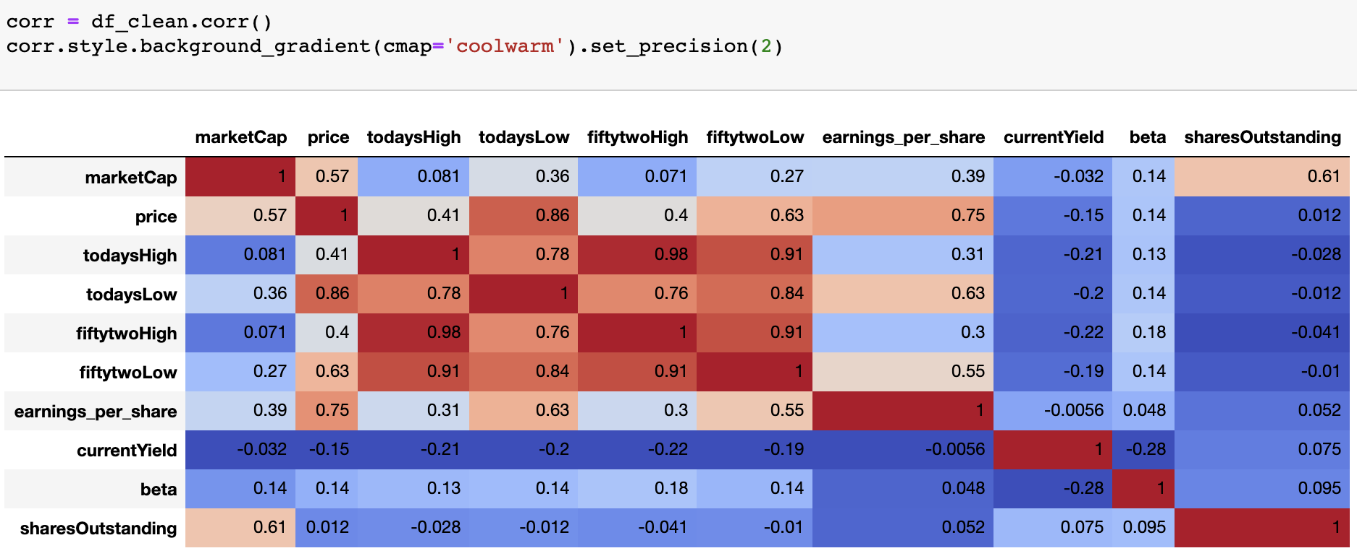
Colors indicate correlation relationship (+ or -), darker hues indicate correlation strength

Slide 12
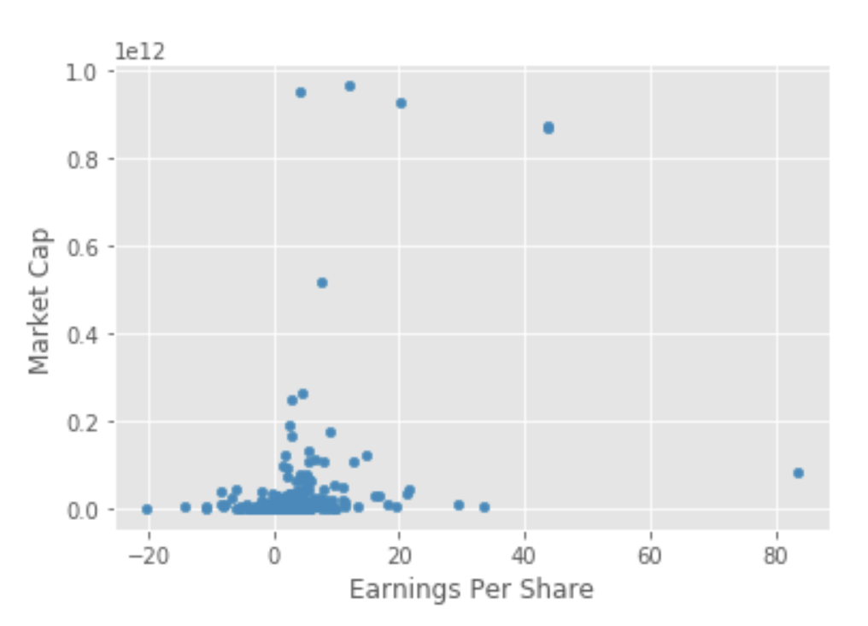
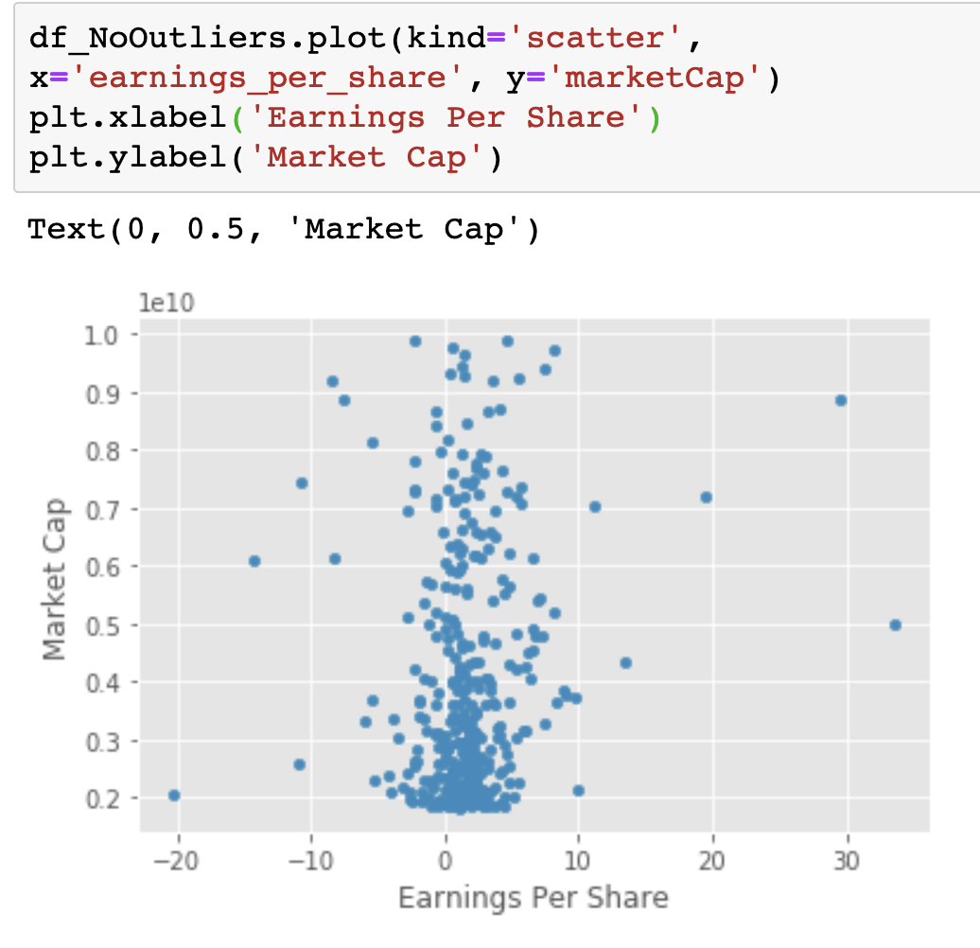
WARNING: Outliers will skew your data

Slide 13
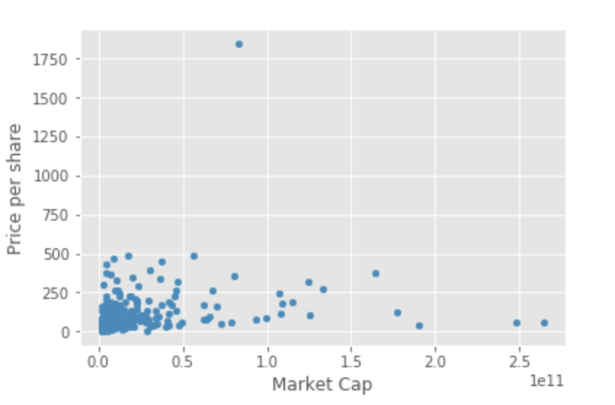
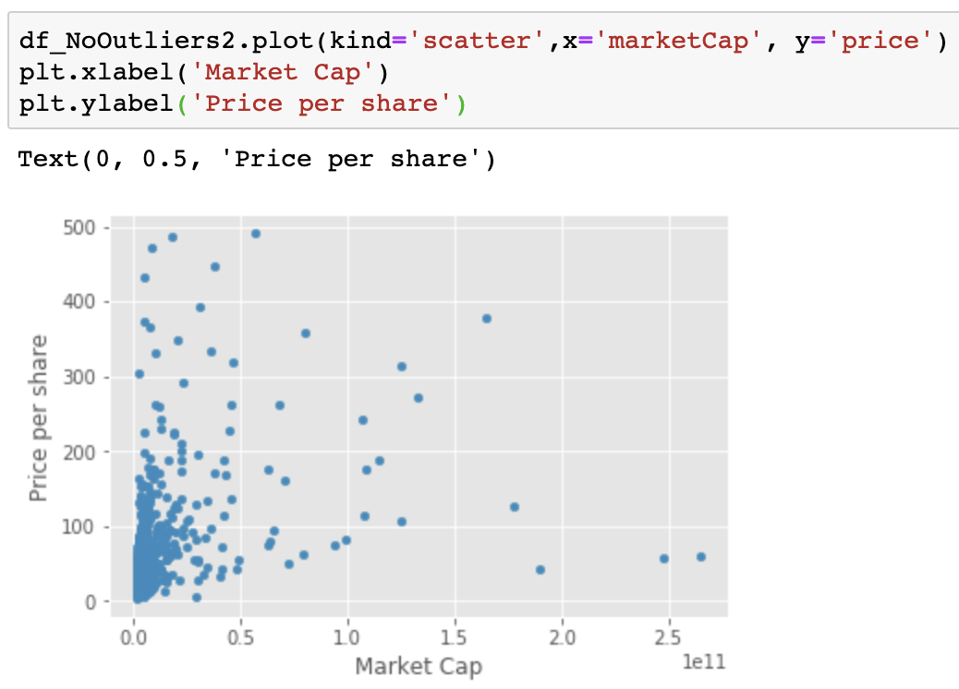

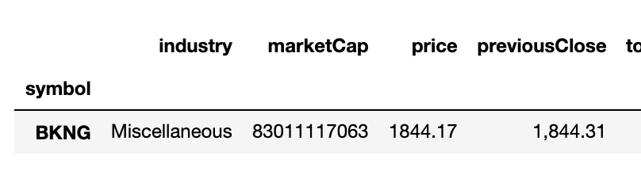
Outliers 2: the skewed dataset strikes back

Slide 14
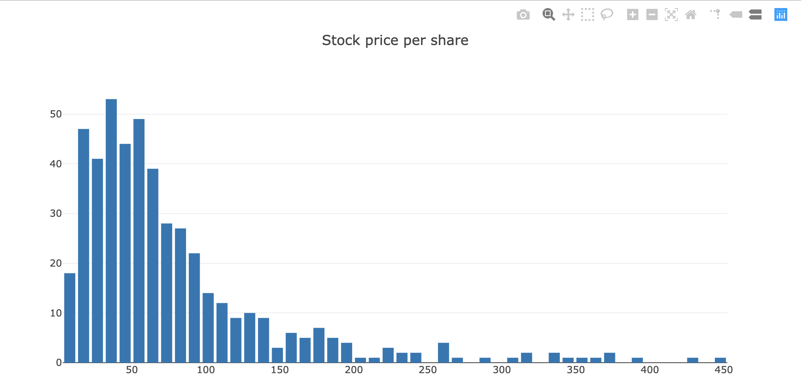
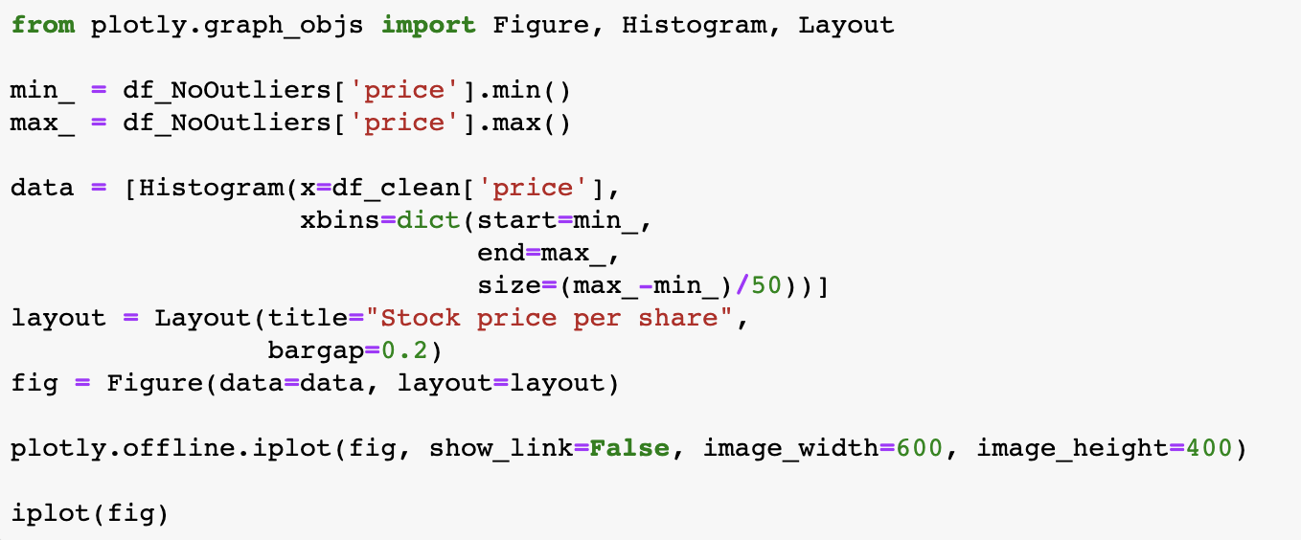
“Look at that neato right-skewed distribution!” - Stats Professor probably

Slide 15
fin
Any questions?

